Slide 1


تجزیه و تحلیل دارو با شبکه عصبی گرافی
رضا طهماسبی
دانشجوی ارشد هوش مصنوعی

Slide 2
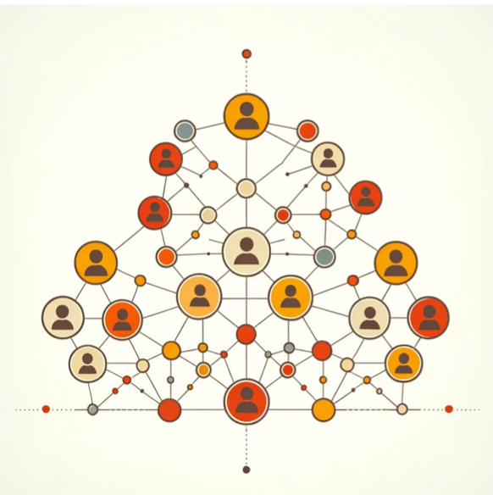
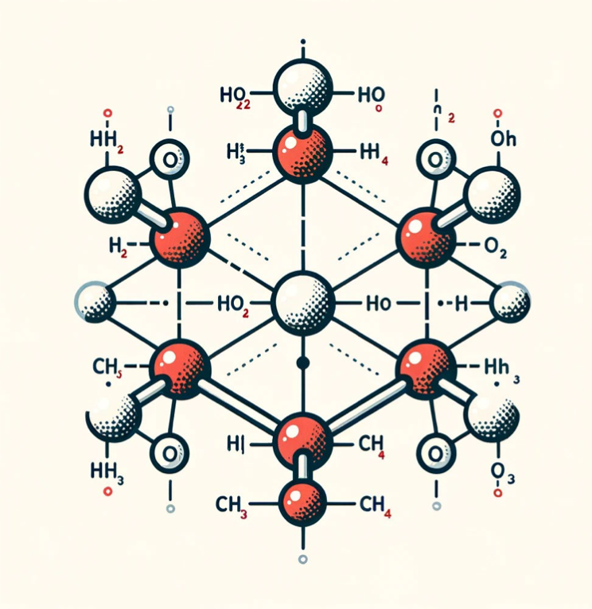
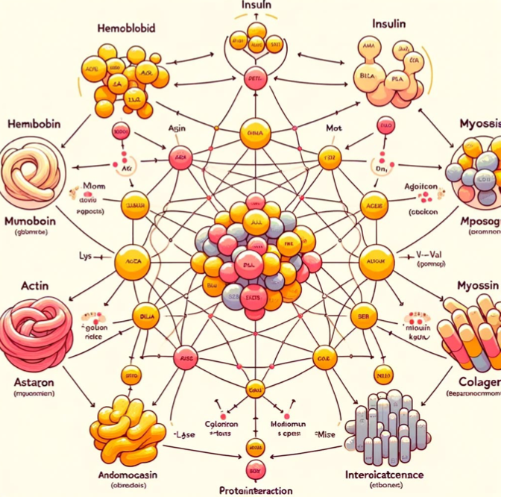

Graphs are structured data
Many real-world datasets come in the form of graphs

Slide 3
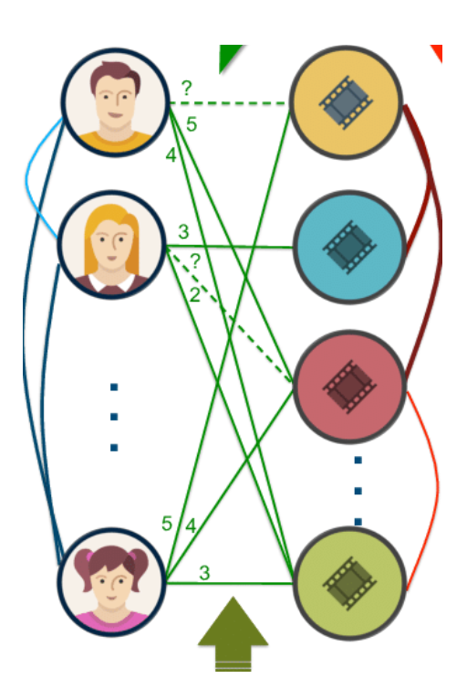
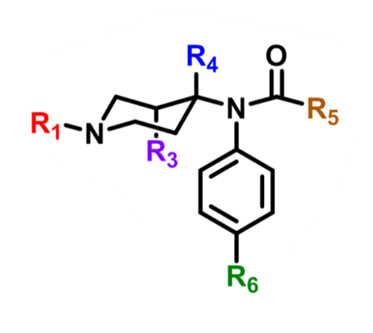
Graph Tasks
Graph-level task
Node-level task
Edge-level task

Slide 4
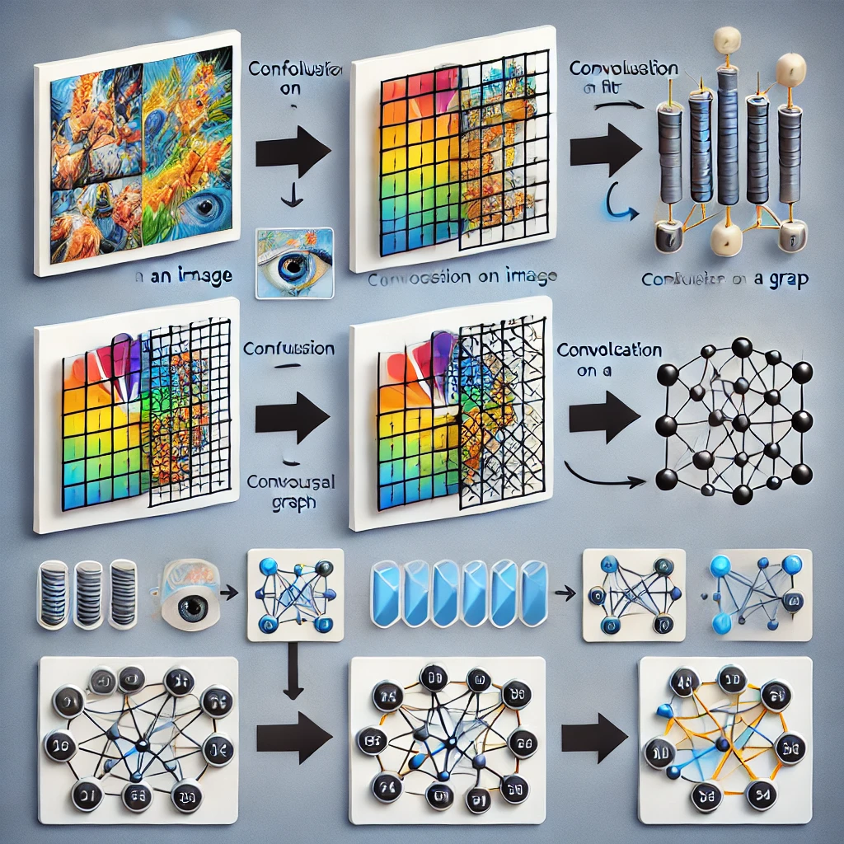
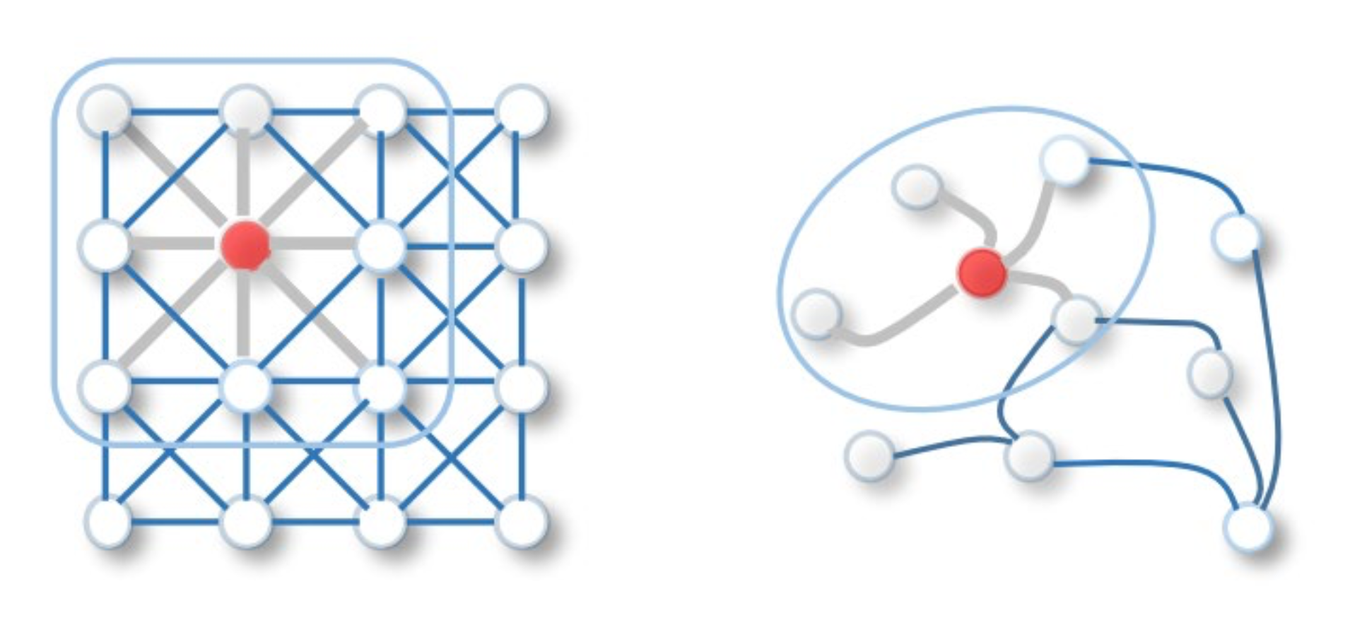
CNN VS GNN
Convolution on a Euclidean Graph
VS
Convolution on a random Graph

Slide 5
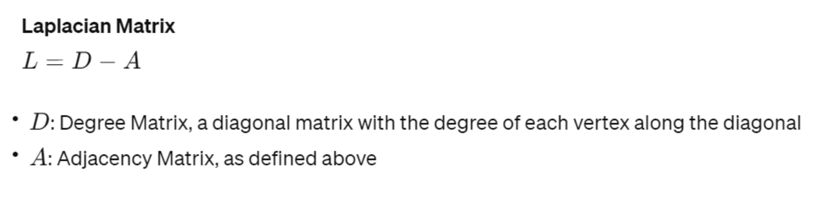
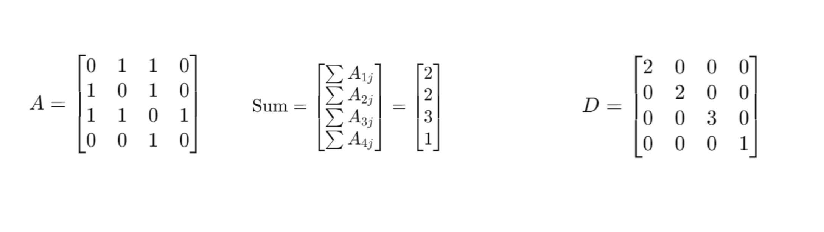
Laplacian of a Graph

Slide 6
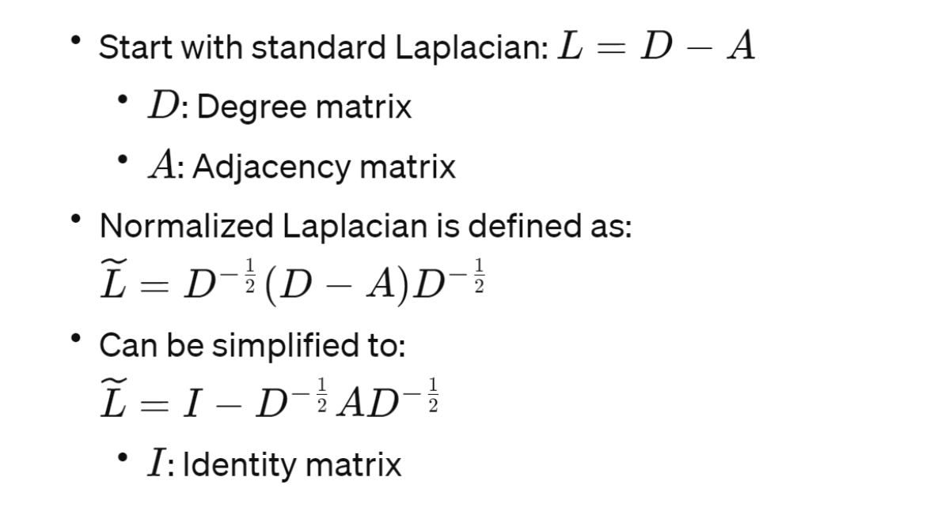
Normalized Laplacian of a Graph

Slide 7
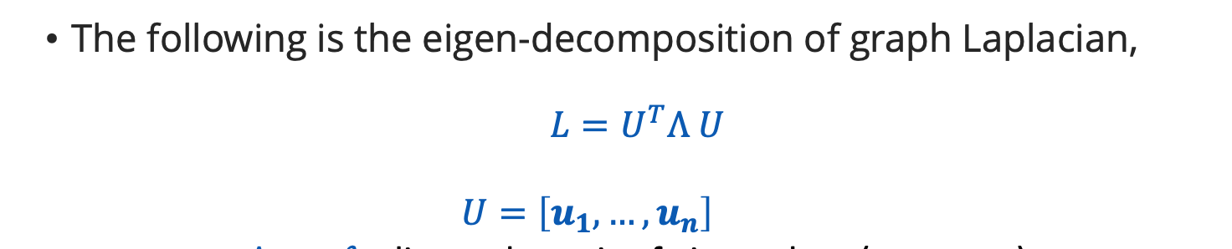
Fourier Transform

Slide 8
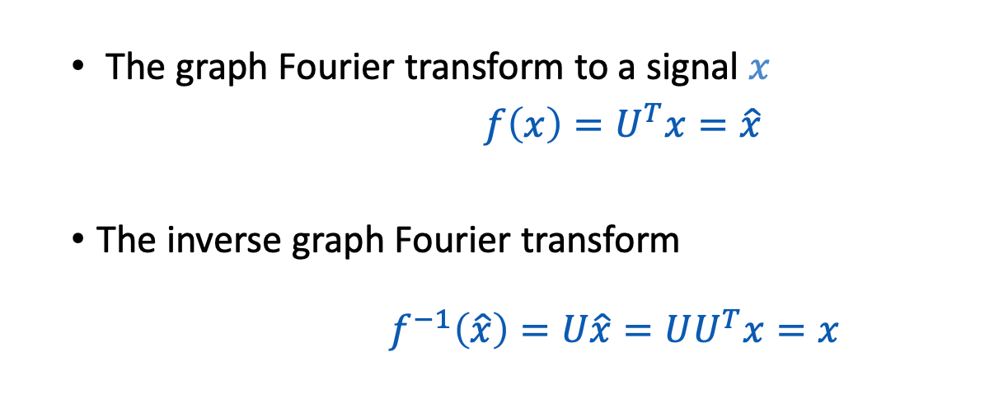
Fourier Transform

Slide 9
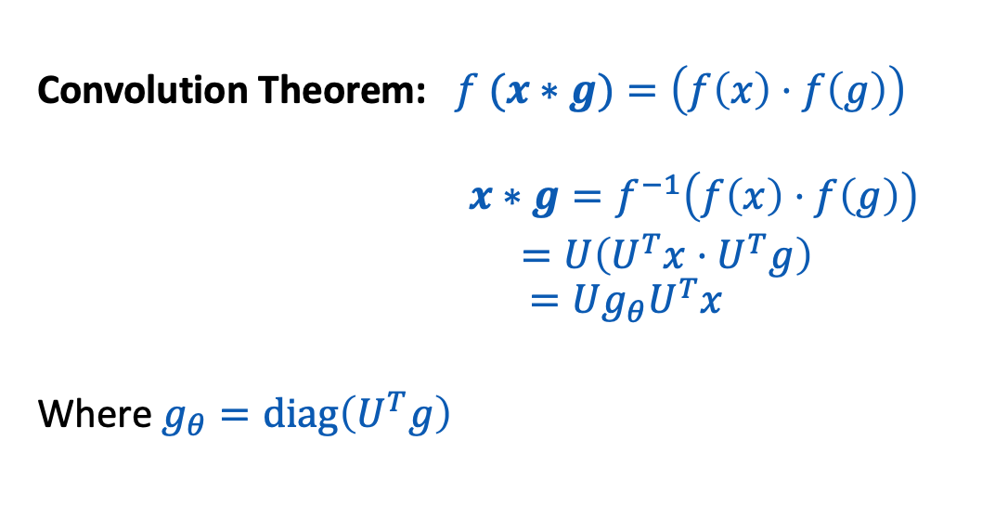
Convolution Theorem

Slide 10
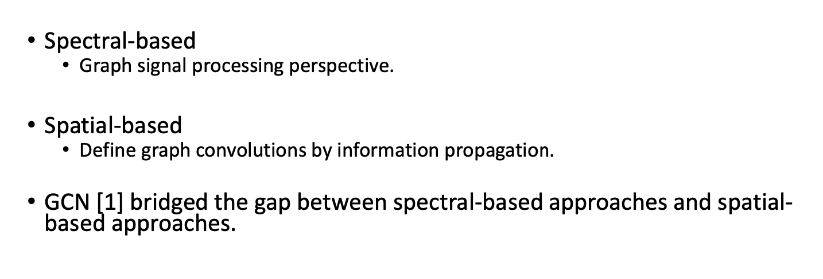
Conv GNN

Slide 11
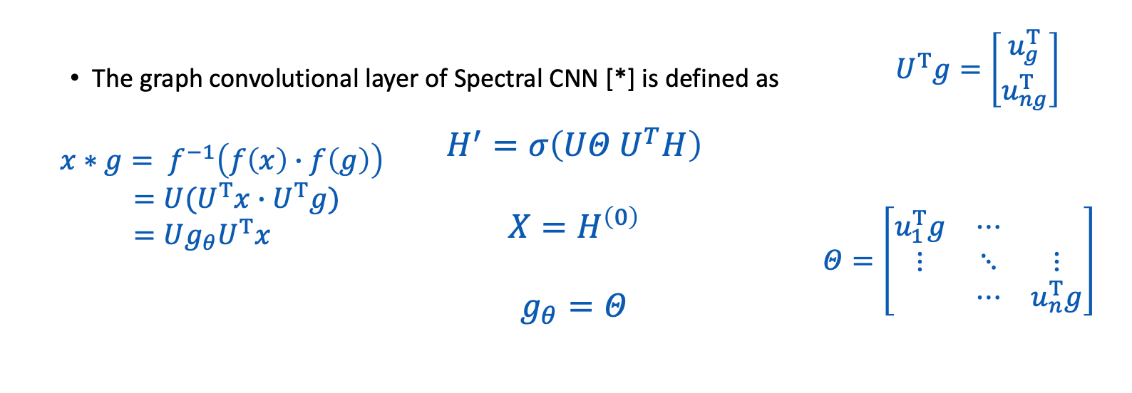
Vanilla Spectral GNN

Slide 12

Limitation
eigen-decomposition requires 𝑂( 𝑛³ )computational complexity.
What is the solution?

Slide 13
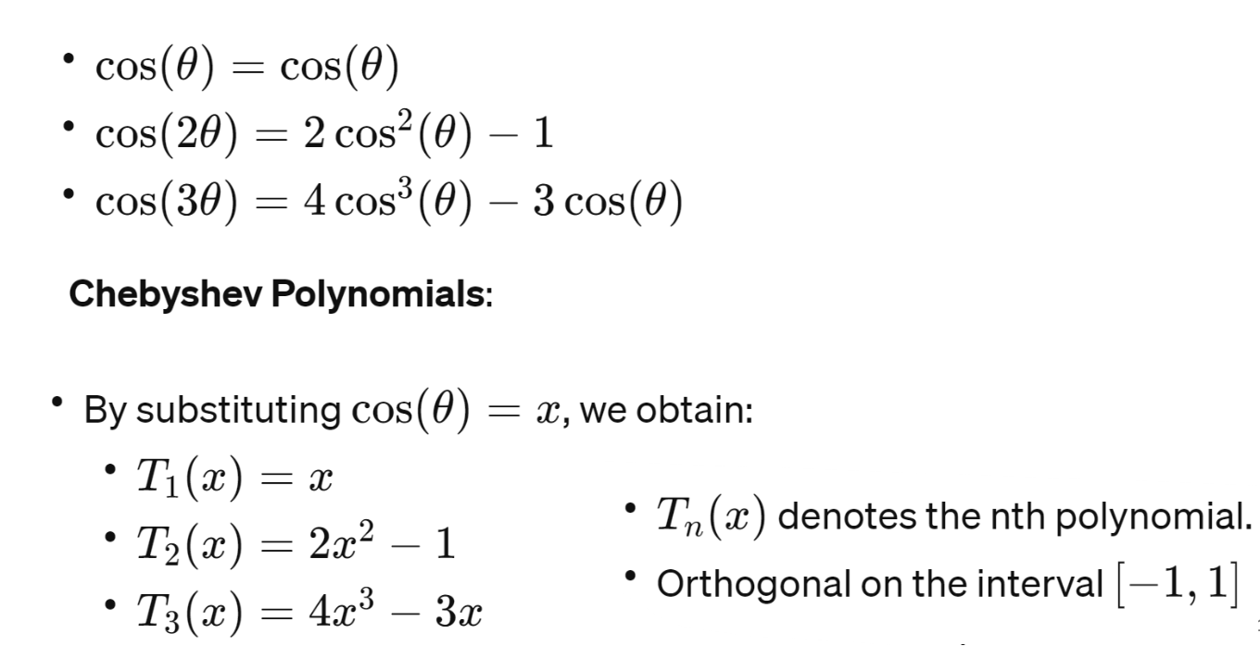
Chebyshev Polynomials

Slide 14
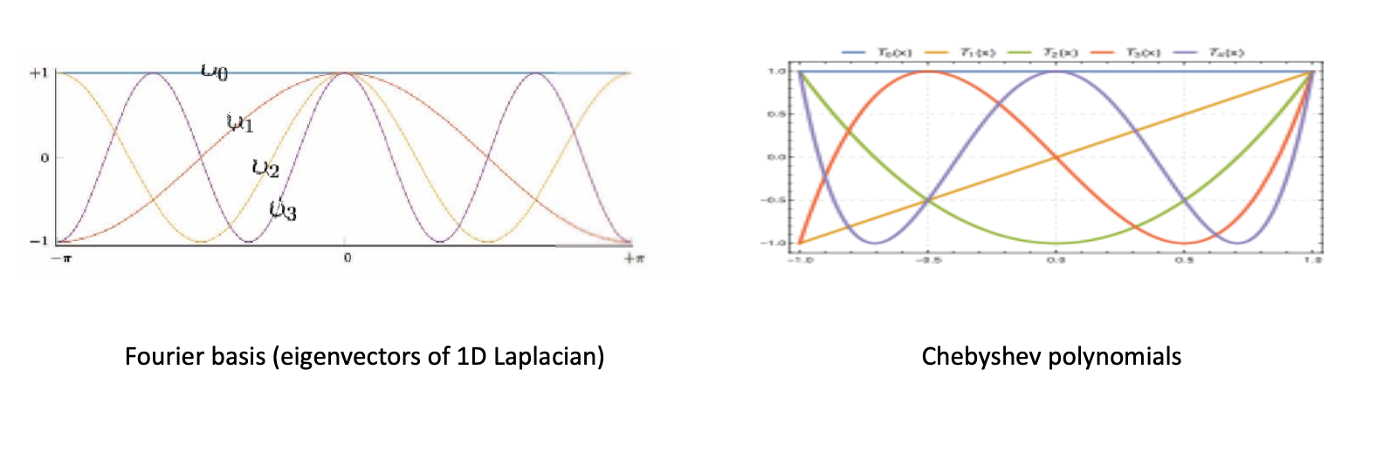
Chebyshev Polynomials

Slide 15
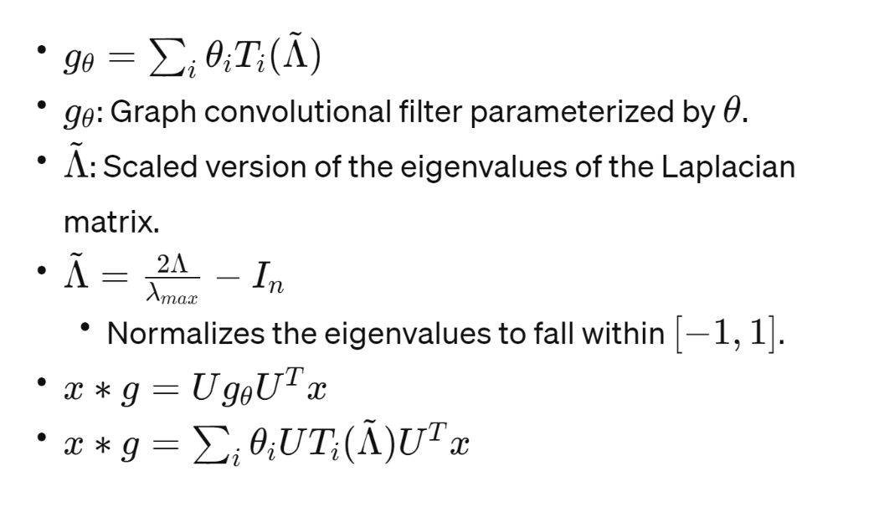
Chebyshev Polynomials

Slide 16
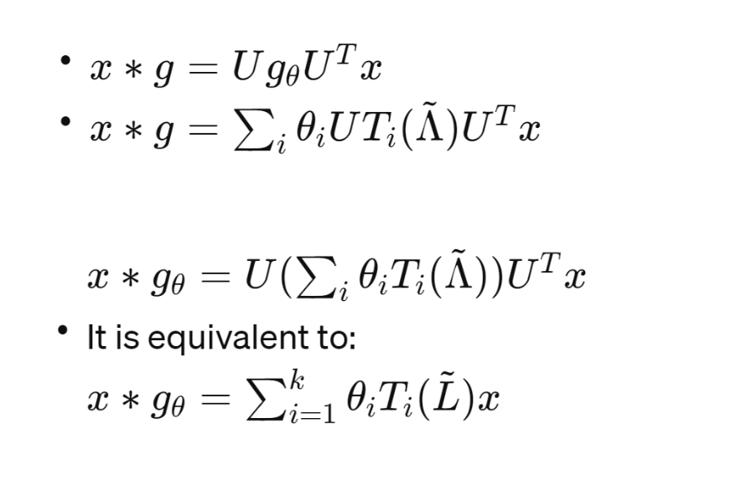
Chebyshev Polynomials

Slide 17
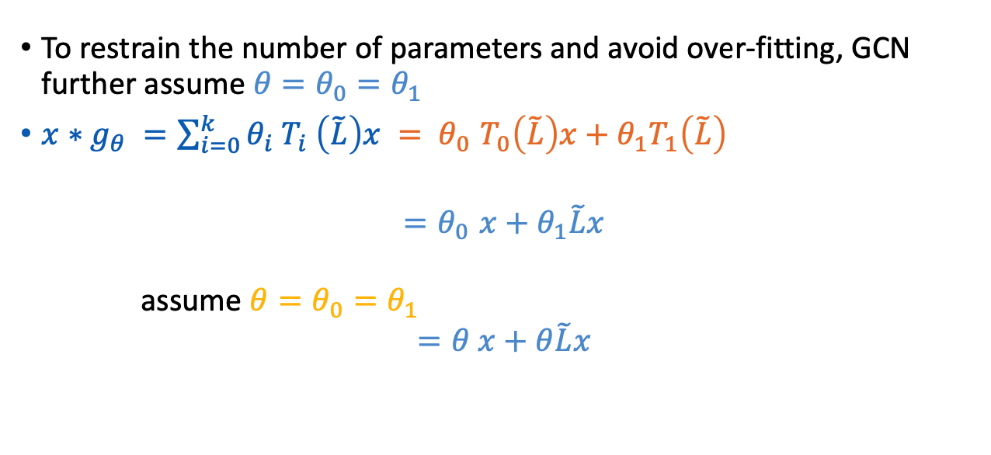
First -order approximation

Slide 18
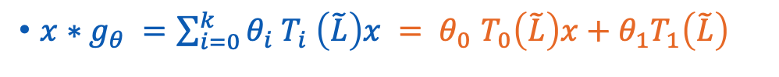
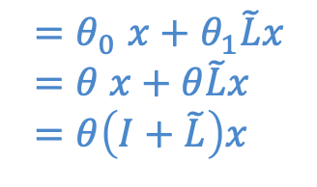
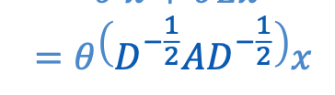
First -order approximation

Slide 19
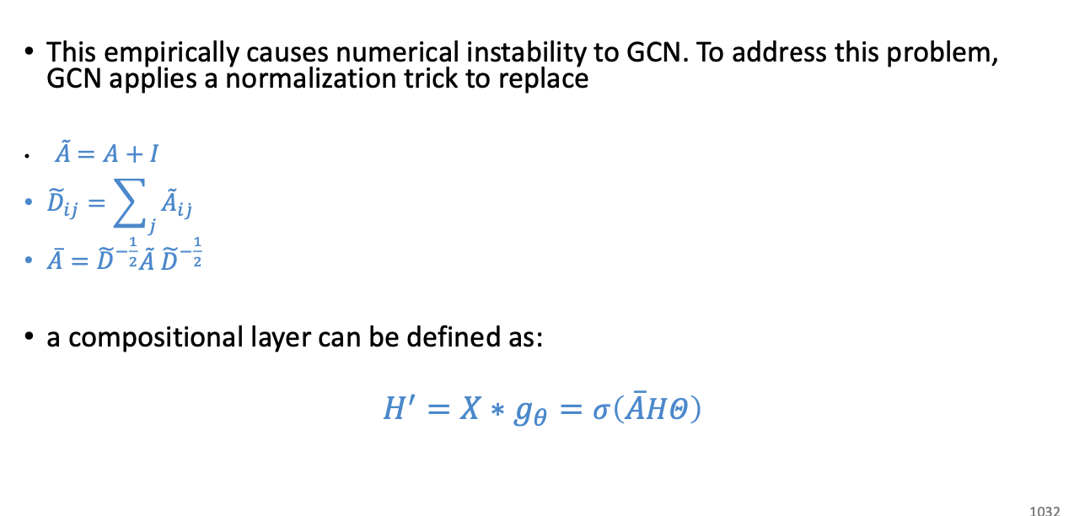
First -order approximation

Slide 20
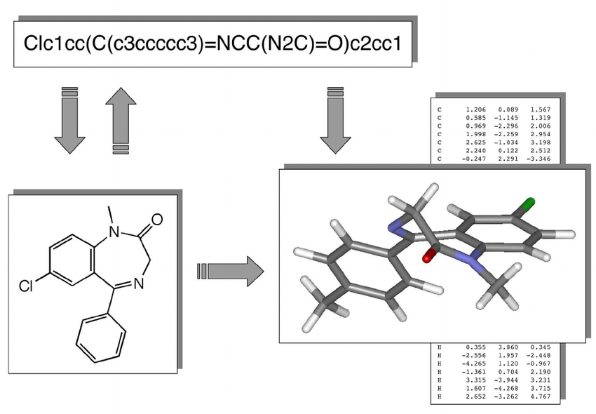
Drugs in AI
To extract representation
of Drug molecules
SMILES strings are used

Slide 21
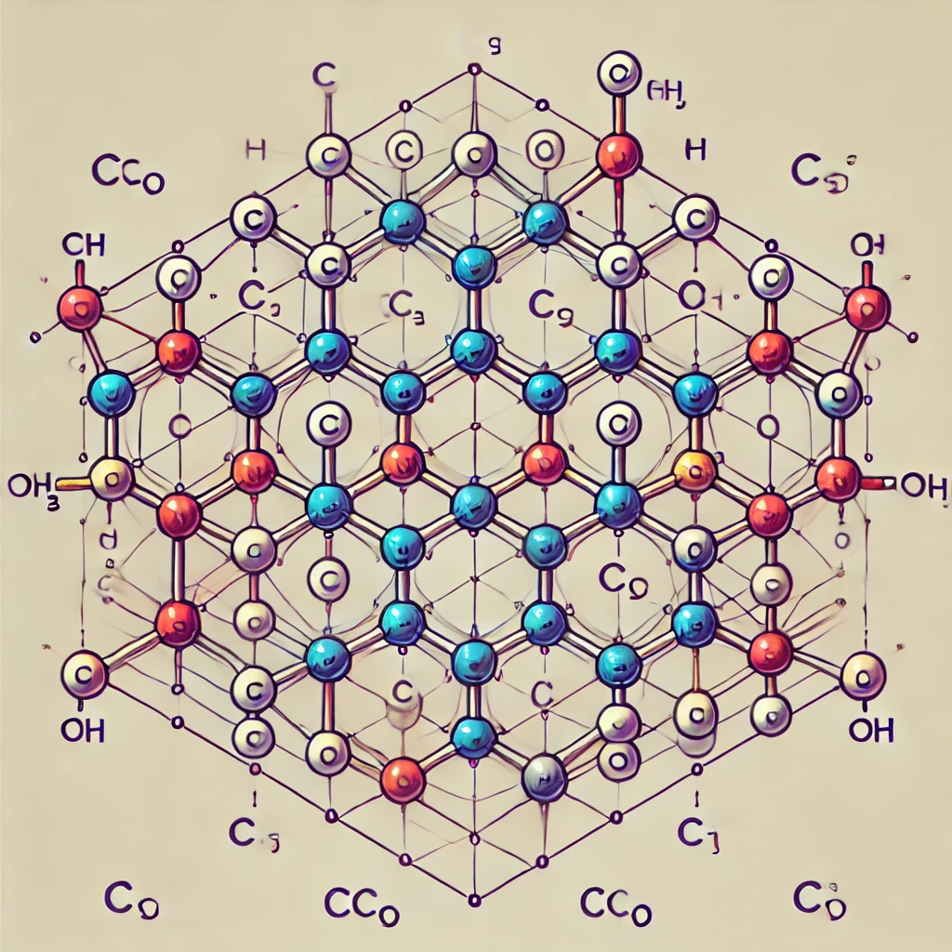
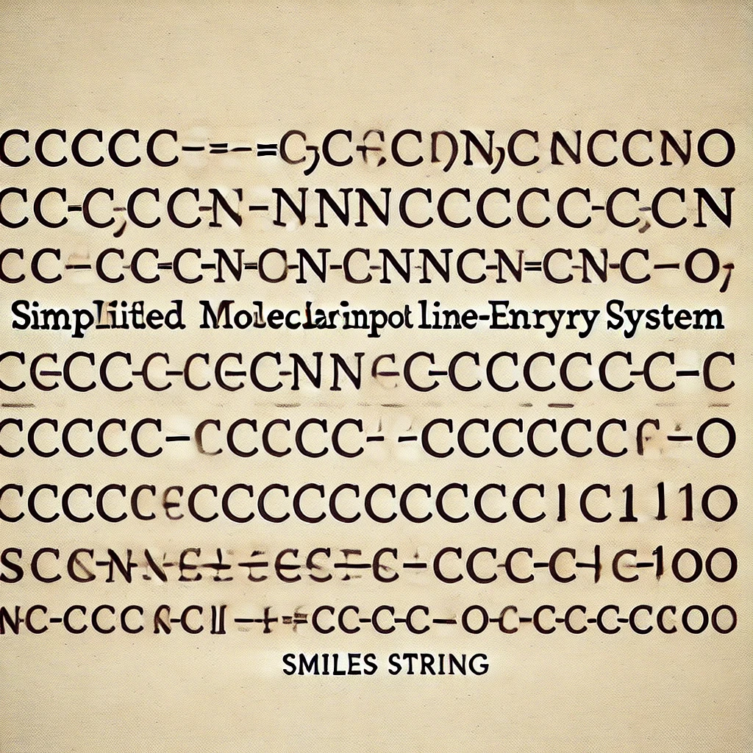
SMILES STRING TO GRAPH
Create molecular graph out of SMILES string

Slide 22
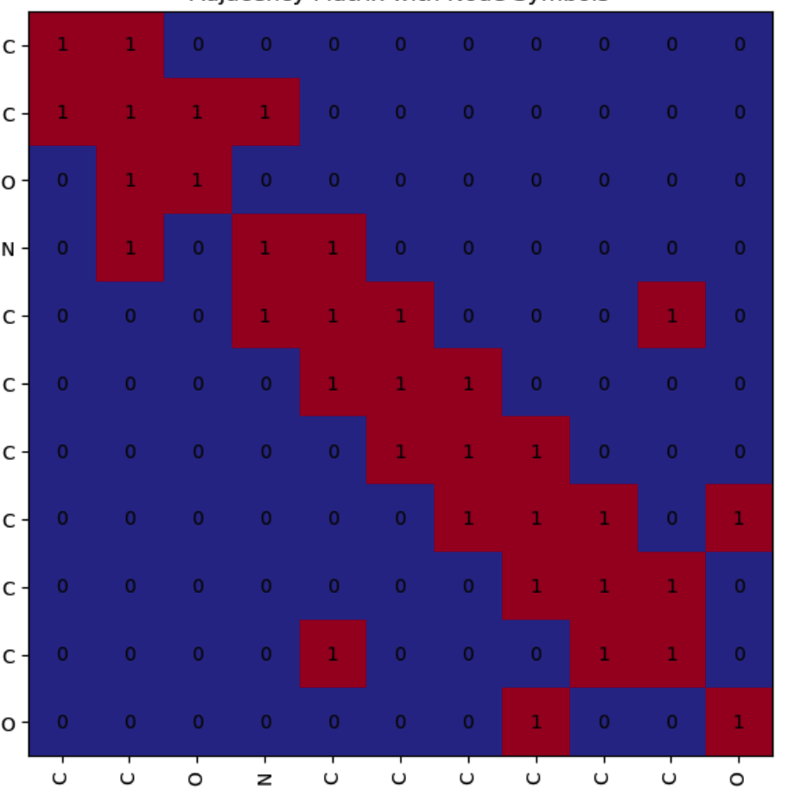
Graph to Adjacency Matrix
Create an Adjacency matrix of the graph based on node connection

Slide 23
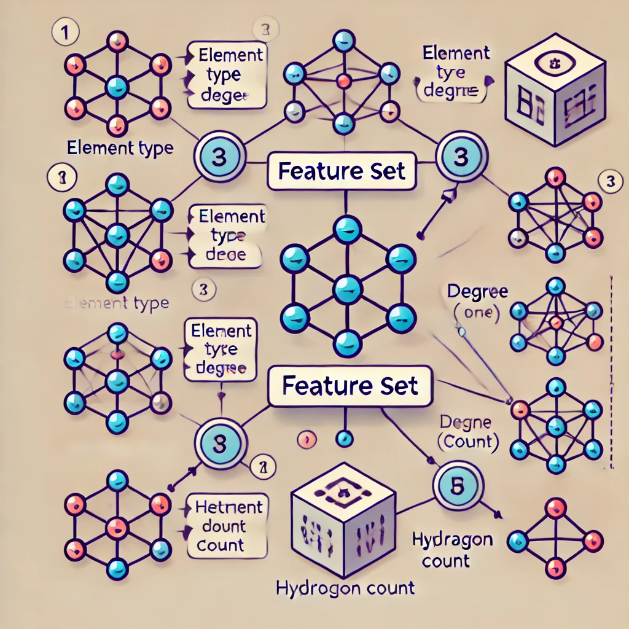
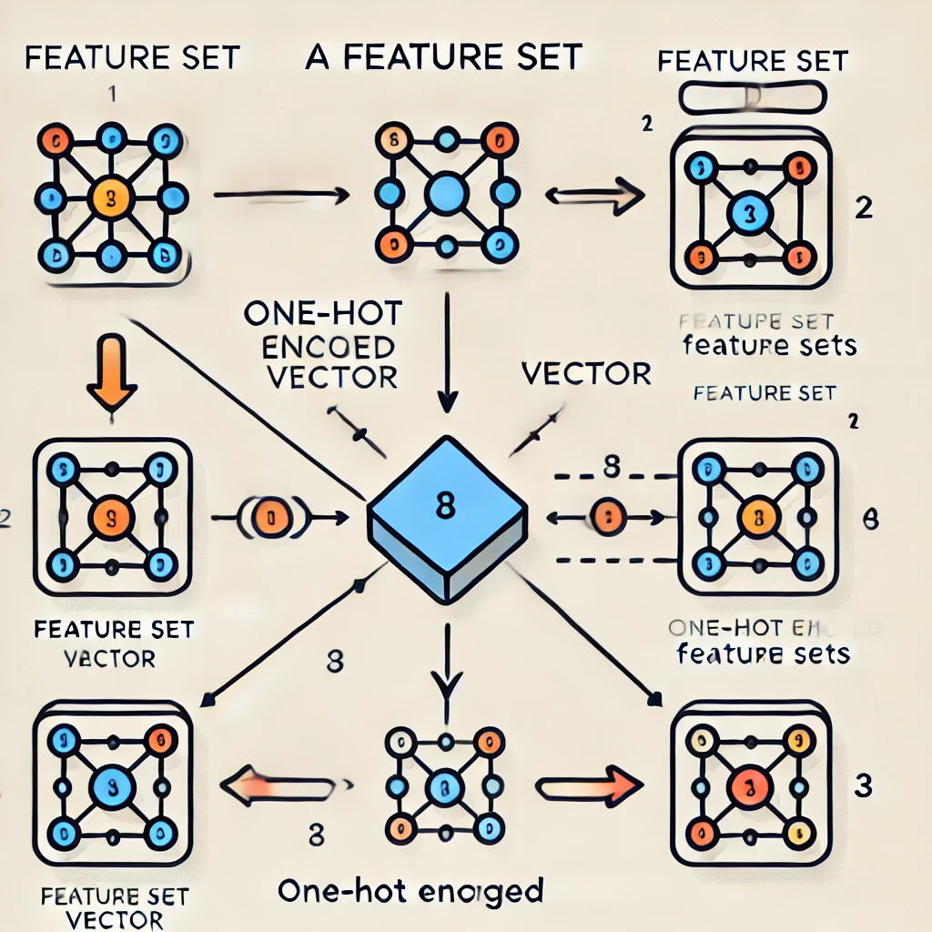
Create a Feature set for each Node
Each node has a Feature vector

Slide 24
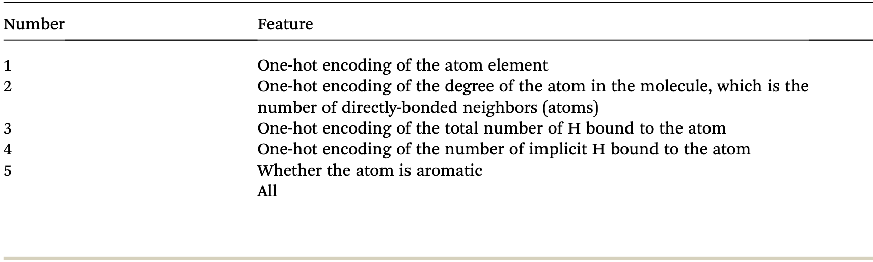
Feature set example

Slide 25
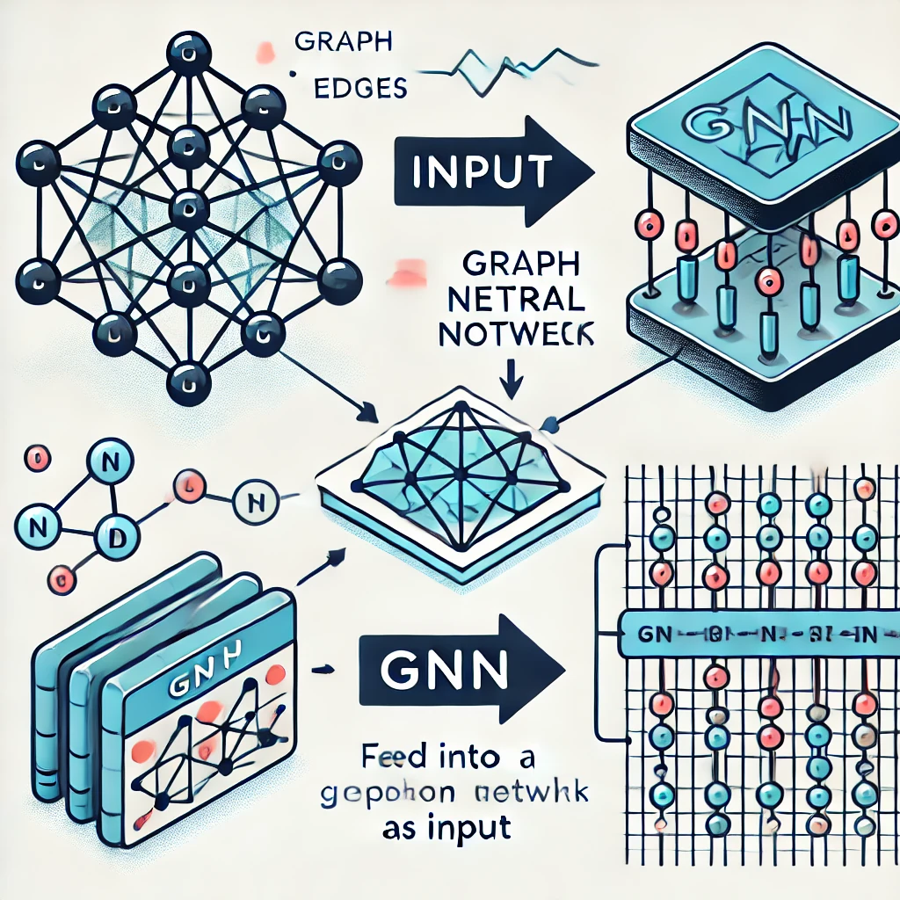
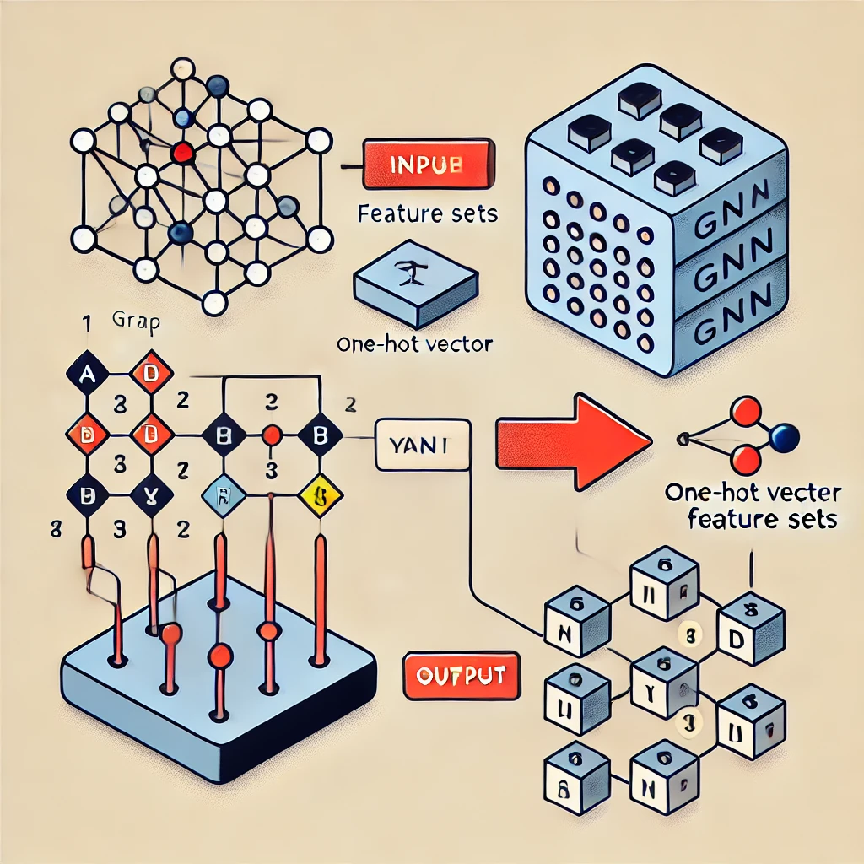
Graph as Input of the GNN

Slide 26
Goals and Targets
Drug–Target Binding Affinity Prediction
Old Drugs, New Uses
Drugs Sides Effect On Each Other

Slide 27
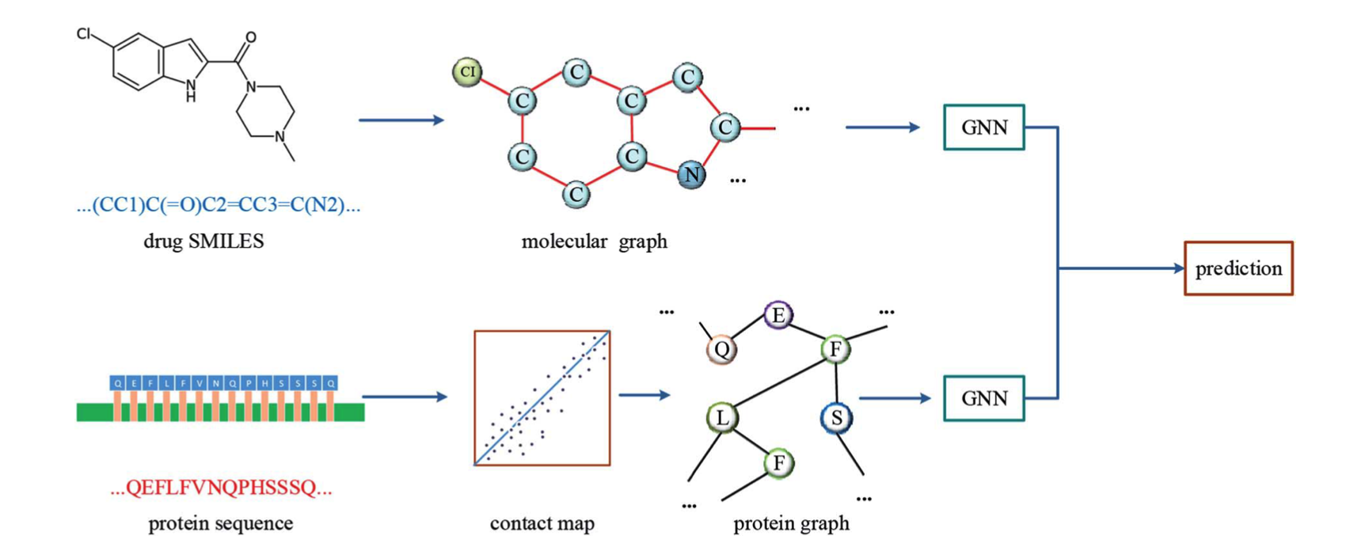
Drug–Target Binding Affinity Prediction

Slide 28
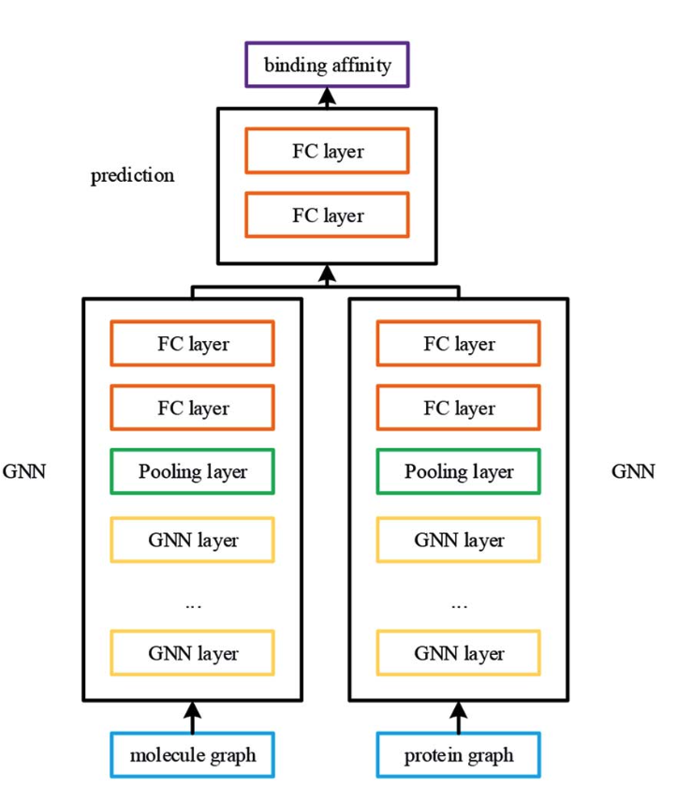
Drug–Target Binding Affinity Prediction

Slide 29
Thanks For Your Attention

